Slide 1
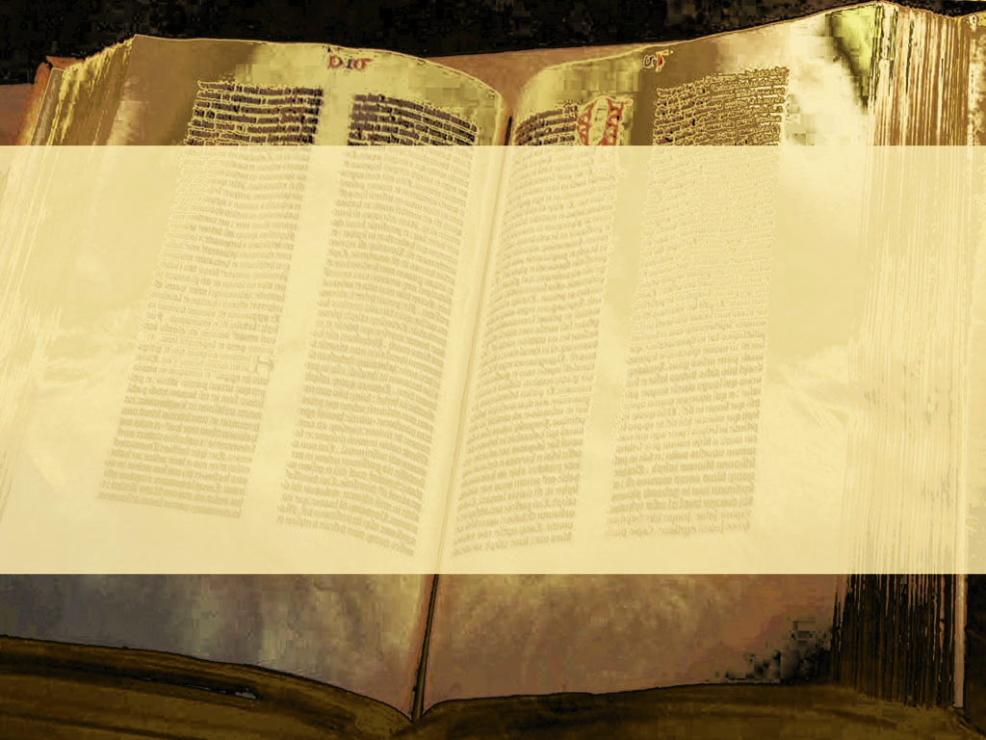

Slide 2
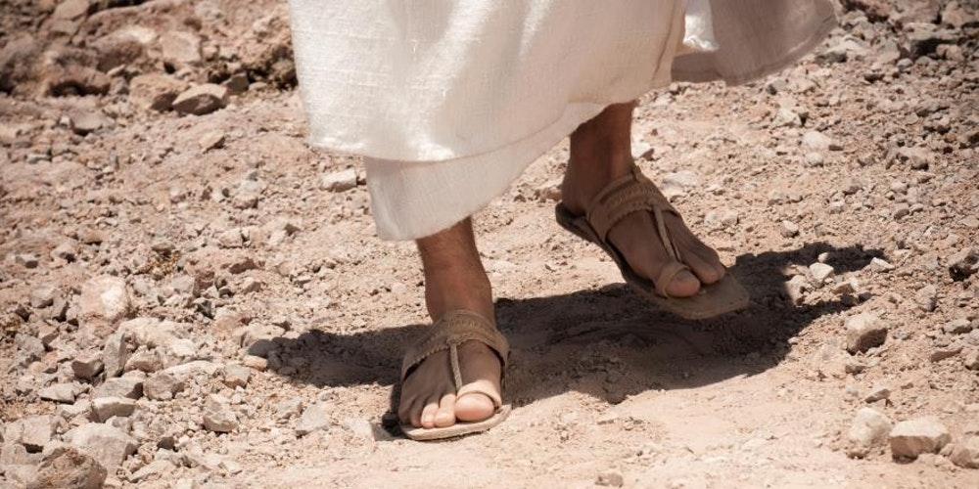
A Journey Through The Life Of Jesus

Slide 3
Unlimited
Unconditional

Slide 4
Passover

Slide 5
And the Jews' passover was nigh at hand: and many went out of the country up to Jerusalem before the passover, to purify themselves.
John 11:55

Slide 6
Now both the chief priests and the Pharisees had given a commandment, that, if any man knew where he were, he should shew it, that they might take him.
John 11:57

Slide 7
On the next day much people that were come to the feast, when they heard that Jesus was coming to Jerusalem,
John 12:12

Slide 8
Took branches of palm trees, and went forth to meet him, and cried, Hosanna: Blessed is the King of Israel that cometh in the name of the Lord.
John 12:13

Slide 9
NATION

Slide 10
YOU
WORLD

Slide 11
Jesus would fulfill
God’s promise to Abraham
and
would replace God’s
covenant with Israel.

Slide 12
Then entered Satan into Judas surnamed Iscariot, being of the number of the twelve.
Luke 22:3

Slide 13
And he went his way, and communed with the chief priests and captains, how he might betray him unto them.
Luke 22:4

Slide 14
And they were glad, and covenanted to give him money.
Luke 22:5

Slide 15
Afraid

Slide 16
And he promised, and sought opportunity to betray him unto them in the absence of the multitude.
Luke 22:6

Slide 17
And as they were eating, Jesus took bread, and blessed it, and brake it, and gave it to the disciples, and said, Take, eat; this is my body.
Matthew 26:26

Slide 18
And he took bread, and gave thanks, and brake it, and gave unto them, saying, This is my body which is given for you…: this do in remembrance of me.
Luke 22:19

Slide 19
And he took bread, and gave thanks, and brake it, and gave unto them, saying, This is my body which is given for you: this do in remembrance… of me.
Luke 22:19

Slide 20
And he took bread, and gave thanks, and brake it, and gave unto them, saying, This is my body which is given for you: this do in remembrance of me.
Luke 22:19

Slide 21
Likewise also the cup after supper, saying, This cup is the new testament in my blood, which is shed for you.
Luke 22:20

Slide 22
Behold, the days come, saith the LORD, that I will make a new covenant with the house of Israel, and with the house of Judah:
Jeremiah 31:31

Slide 23
Not according to the covenant that I made with their fathers in the day that I took them by the hand to bring them out of the land of Egypt;
Jeremiah 31:32

Slide 24
which my covenant they brake, although I was an husband unto them, saith the LORD:
Jeremiah 31:32

Slide 25
But this shall be the covenant that I will make with the house of Israel; After those days, saith the LORD,
Jeremiah 31:33

Slide 26
I will put my law in their inward parts, and write it in their hearts; and will be their God, and they shall be my people.
Jeremiah 31:33

Slide 27
“This cup is the new testament”
Luke 22:20

Slide 28
Bilateral Parity Covenant
Bilateral Suzerainty Covenant
Promissory Covenant

Slide 29
Genesis 15:1-21
The Abrahamic Covenant

Slide 30
May it be unto me
as it is with these animals
if I violate the terms of
this covenant.

Slide 31
In the same day the LORD made a covenant with Abram…
Genesis 15:18

Slide 32
This cup is the new testament in my blood, which is shed for you.
Luke 22:20

Slide 33
For you
On Me

Slide 34
This cup is the new testament in my blood, which is shed for you.
Luke 22:20
…for the forgiveness of sins.
Matthew 22:28

Slide 35
Temple Equation

Slide 36
Behold the Lamb of God, which taketh away the sin of the world…
John 1:29

Slide 37
A New Covenant
An Unconditional Covenant
A Promissory Covenant

Slide 38
…that whoever believeth in Him should not perish, but have everlasting life.
John 3:16

Slide 39
On Me
For you

