Slide 1
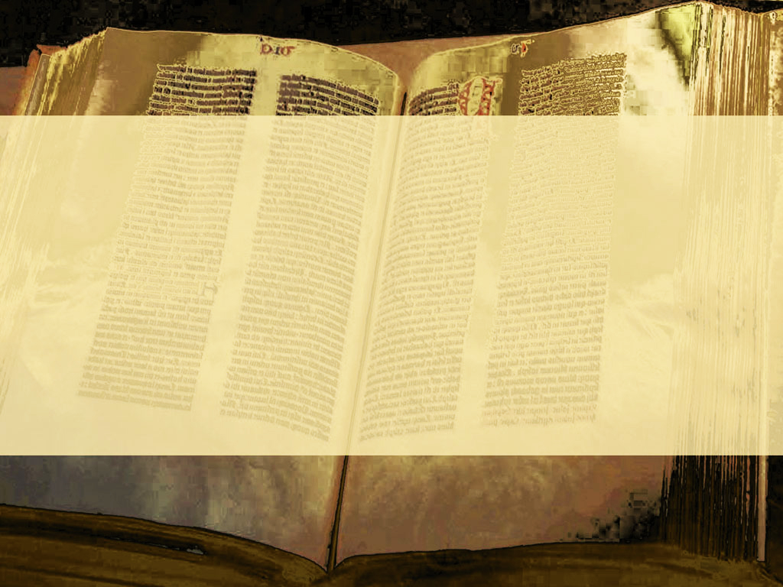

Slide 3
No situation seems so bleak, so demoralizing, so heartbreaking as to be in the situation of having no hope.

Slide 4
When all hope is lost,
only one solution remains.
Divine Intervention

Slide 5
“But God…”
Ephesians 2:4.

Slide 6
“But God”
God stepping into human existence is the only
best thing possible.

Slide 7
“For my thoughts are not your thoughts, neither are your ways my ways, saith the LORD. For as the heavens are higher than the earth, so are my ways higher than your ways and my thoughts than your thoughts.”
Isaiah 55:8-9.

Slide 8
“But God, who is rich in mercy, for his great love wherewith he loved us”
Ephesians 2:4.

Slide 9
“But God, who is rich in mercy, for his great love wherewith he loved us”
Ephesians 2:4.

Slide 10
For the human existence, God’s mercy is of high value.
What other value compares to not getting what you deserve?

Slide 11
“For the wages of sin is death…”
Romans 6:23.

Slide 12
“For the wages of sin is death; but the gift of God is eternal life through Jesus Christ our Lord.”
Romans 6:23.

Slide 13
“But God, who is rich in mercy, for his great love wherewith he loved us”
Ephesians 2:4.

Slide 14
“But God, who is rich in mercy, for his great love wherewith he loved us”
Ephesians 2:4.

Slide 15
“But God, who is rich in mercy, for his great love wherewith he loved us”
Ephesians 2:4.

Slide 16
“Even when we were dead in sins…”
Ephesians 2:5.

Slide 17
“when we were”
The circumstances,
the conditions of
being of humans.

Slide 18
“Even when we were dead in sins…”
Ephesians 2:5.

Slide 19
“dead” – dead ones
or dead corpses.
Beyond human remedy

Slide 20
“Even when we were dead in sins, hath quickened us together with Christ…”
Ephesians 2:5.

Slide 21
The only One Who could remedy the being dead human condition intervened and
did remedy that condition.

Slide 22
“For ye are all the children of God by faith in Christ Jesus. For as many of you as have been baptized into Christ have put on Christ.”
Galatians 3:26-27.

Slide 23
“Even when we were dead in sins, hath quickened us together with Christ, (by grace ye are saved;)”
Ephesians 2:5.

Slide 24
“And hath raised us up together, and made us sit together in heavenly places in Christ Jesus:”
Ephesians 2:6.

Slide 25
This is not pie in the sky
in the bye and bye.
This is down here on the ground whilst you’re still around.
This is here and now!

Slide 26
“That in the ages to come he might shew the exceeding riches of his grace in his kindness toward us through Christ Jesus.”
Ephesians 2:7.

Slide 27
“That in the ages to come he might shew the exceeding riches of his grace in his kindness toward us through Christ Jesus.”
Ephesians 2:7.

Slide 28
“That in the ages to come he might shew the exceeding riches of his grace in his kindness toward us through Christ Jesus.”
Ephesians 2:7.

Slide 29
Everything necessary to put the exceeding richness of His
grace on display as proof
will be put on display.

Slide 30
Apart from trusting in Jesus Christ, you are beyond all human remedy.
“But God” is your only solution.

