Slide 1
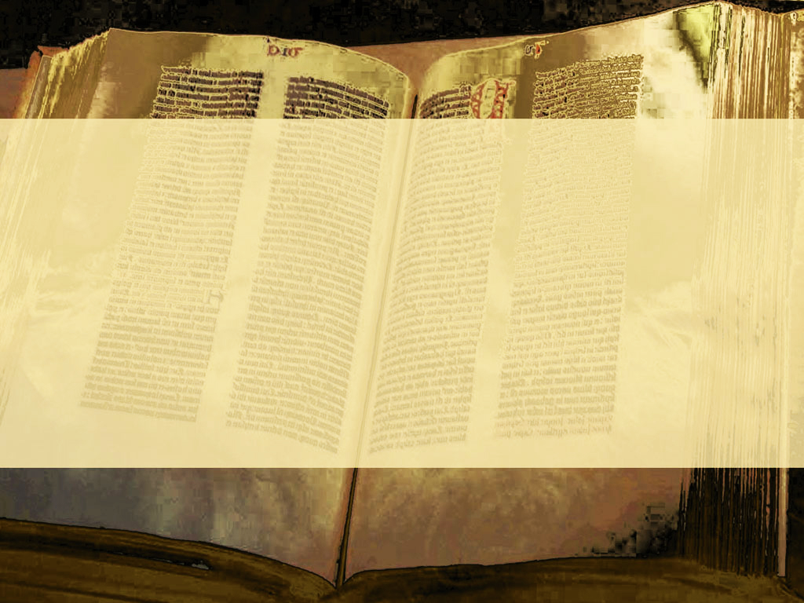

Slide 3
The definitive teaching
of what a church is
The Dome – Chapters 1-3.
Living Under the Dome – Chapters 4-6.

Slide 4
What’s a good way to better appreciate what you are now?
Remember where you once were, the work it took and the sacrifices made to get here.

Slide 5
Where we are now is beyond our ability to achieve.
The sacrifice to get us here
was not made by us.

Slide 6
“And you hath he quickened, who were dead in trespasses and sins”
Ephesians 2:1.

Slide 7
The highest level of
life is to be the
body of Jesus Christ.

Slide 8
“And you hath he quickened, who were dead in trespasses and sins”
Ephesians 2:1.

Slide 9
“dead” – dead ones
or dead corpses.
Beyond human remedy

Slide 10
“Wherefore, as by one man sin entered into the world, and death by sin; and so death passed upon all men, for that all have sinned”
Romans 5:12.

Slide 11
“And you hath he quickened, who were dead in trespasses and sins”
Ephesians 2:1.

Slide 12
Trespasses and sins are deliberate acts of rebellion against God that reference the fact of our dead condition.

Slide 13
“Wherein in time past ye walked according to the course of this world…”
Ephesians 2:2a.

Slide 14
“according to the prince of the power of the air, the spirit that now worketh in the children of disobedience”
Ephesians 2:2b.

Slide 15
This ruler is Satan
Jesus refers to Satan as the Prince of this world
(John 12:32; 14:30; 16:11).

Slide 16
“according to the prince of the power of the air, the spirit that now worketh in the children of disobedience”
Ephesians 2:2b.

Slide 17
“according to the prince of the power of the air, the spirit that now worketh in the children of disobedience”
Ephesians 2:2b.

Slide 18
“Among whom also we all had our conversation in times past in the lusts of our flesh, fulfilling the desires of the flesh and of the mind.”
Ephesians 2:3a.

Slide 19
“we” – change in number
Either “we” meaning Jews
as opposed to Gentiles or
“we” meaning Apostles as
opposed to other believers

Slide 20
“…and were by nature the children of wrath, even as others.”
Ephesians 2:3b.

Slide 21
If this is all there is,
then were in trouble!
“But God…”
Ephesians 2:4.

